Slide 1

AI-Driven Integrated Course Registration and Student Academic Management System for Intelligent Academic Planning and Administration
SOA Project Review-1
September 2026
 | Under the Guidance of Neelima Gogineni Professor, Department of Computer Science and Engineering, KLH CSE Bowrampet Campus
Team Members Y. Gowtham Reddy (2420030522) G. Devaki Nandan Varma (2420030532) M. Arjun Reddy (2420030559)

Slide 2

Outline of Project Work
Focus
Introduction
Literature Survey
Challenges
Research Objectives
Conclusion & Future Work
References
Publications Details

Slide 3
Problem Statement
University course registration and academic administration still rely on disjointed, manually operated systems that treat enrollment, timetable clashes, prerequisite checks, and academic advising as separate, loosely connected activities.
This fragmentation leads to registration bottlenecks, seat-allocation conflicts, delayed academic guidance, and heavy administrative overhead for both students and faculty.
As student populations and elective course catalogues continue to grow, disconnected legacy tools cannot scale to meet demand or provide timely, accurate guidance.
There is a pressing need for a unified, intelligent, and scalable platform that automates registration while proactively supporting academic planning in real time.

Slide 4
Objectives
Unify course registration, student records management, and academic advising into a single, cohesive platform.
Design the backend as independently deployable Spring Boot microservices under a Service-Oriented Architecture (SOA) for scalability, fault isolation, and maintainability.
Build a responsive React.js single-page application to deliver a modern, intuitive front-end experience.
Secure every API endpoint with JWT-based authentication and enforce role-based access for students, faculty, and administrators.
Integrate the Gemini API into the planning service to generate personalized course recommendations, flag scheduling conflicts, and provide natural-language academic guidance.
Maintain persistent data through MySQL, with each microservice owning its own schema to preserve data ownership and consistency.
Establish an industry-standard development pipeline using Maven, Postman, and Git/GitHub for builds, API testing, and collaborative version control.

Slide 5
Literature Survey
Authors | Title of the Paper | Methodology | Inferences | Limitation/Future work
Chaudhary et al. (2024) | The Impact of AI-Based Course-Recommender Systems on Students' Course-Selection Decision-Making, MDPI Applied Sciences | Speed-dating study exposing students to AI-based course recommender systems; thematic analysis of resulting perceptions | Students expect AI recommenders to retrieve, filter, and visualize course information during search, and to quantify hard-to-evaluate qualitative signals during evaluation | Study is perception-based rather than a deployed system; does not address registration-time conflict detection or scheduling
Xu et al. (2023) — DORIS | DORIS: Personalized Course Recommendation System Based on Deep Learning, PMC | Deep Factorization Machine (DeepFM) combined with TextRank and PCA to model course text features and student interests | Achieved an AUC of 0.969 for course recommendation, notably higher than baseline collaborative-filtering methods | Focuses purely on recommendation accuracy; not integrated with live registration, prerequisite validation, or advising workflows
Rusu et al. — One-Gateway System | One-Gateway System in Managing Campus Information Systems Using Microservices Architecture | API Gateway routing requests to independently deployable microservices built on Spring Cloud, replacing a monolithic campus system | Demonstrated improved decoupling, easier maintenance, and independent scalability of campus services under real deployment | Focused on infrastructure/administration services; does not incorporate AI-driven academic planning or advising

Slide 6
Problem Gap Identification
Existing university ERPs treat registration, records, and advising as siloed modules with no real-time cross-linking between them.
Timetable clashes and prerequisite checks are typically validated manually or only after submission, so conflicts surface late instead of being prevented at the point of registration.
Academic advising in most systems is reactive and generic — it is not personalized to a student's live progress toward degree requirements.
Few existing platforms combine the scalability of microservices with AI-based, natural-language guidance grounded in a student's actual academic record.
There is no widely available, unified, role-based, API-secured platform that ties registration, records, and intelligent planning into one system.

Slide 7
Innovation, Creativity, and Novelty
Combines a Service-Oriented microservices backend with generative AI (Gemini API) to deliver real-time, context-aware academic planning rather than static rule-based advising.
An intelligent planning service proactively flags seat, timetable, and prerequisite conflicts during registration instead of after submission.
A natural-language advising assistant grounded in each student's actual academic history and remaining degree requirements, not generic course catalogues.
Independently deployable microservices give fault isolation and elastic scalability that monolithic campus ERPs typically lack.
Uniform JWT-based, role-based security enforced across every API endpoint for students, faculty, and administrators.

Slide 8
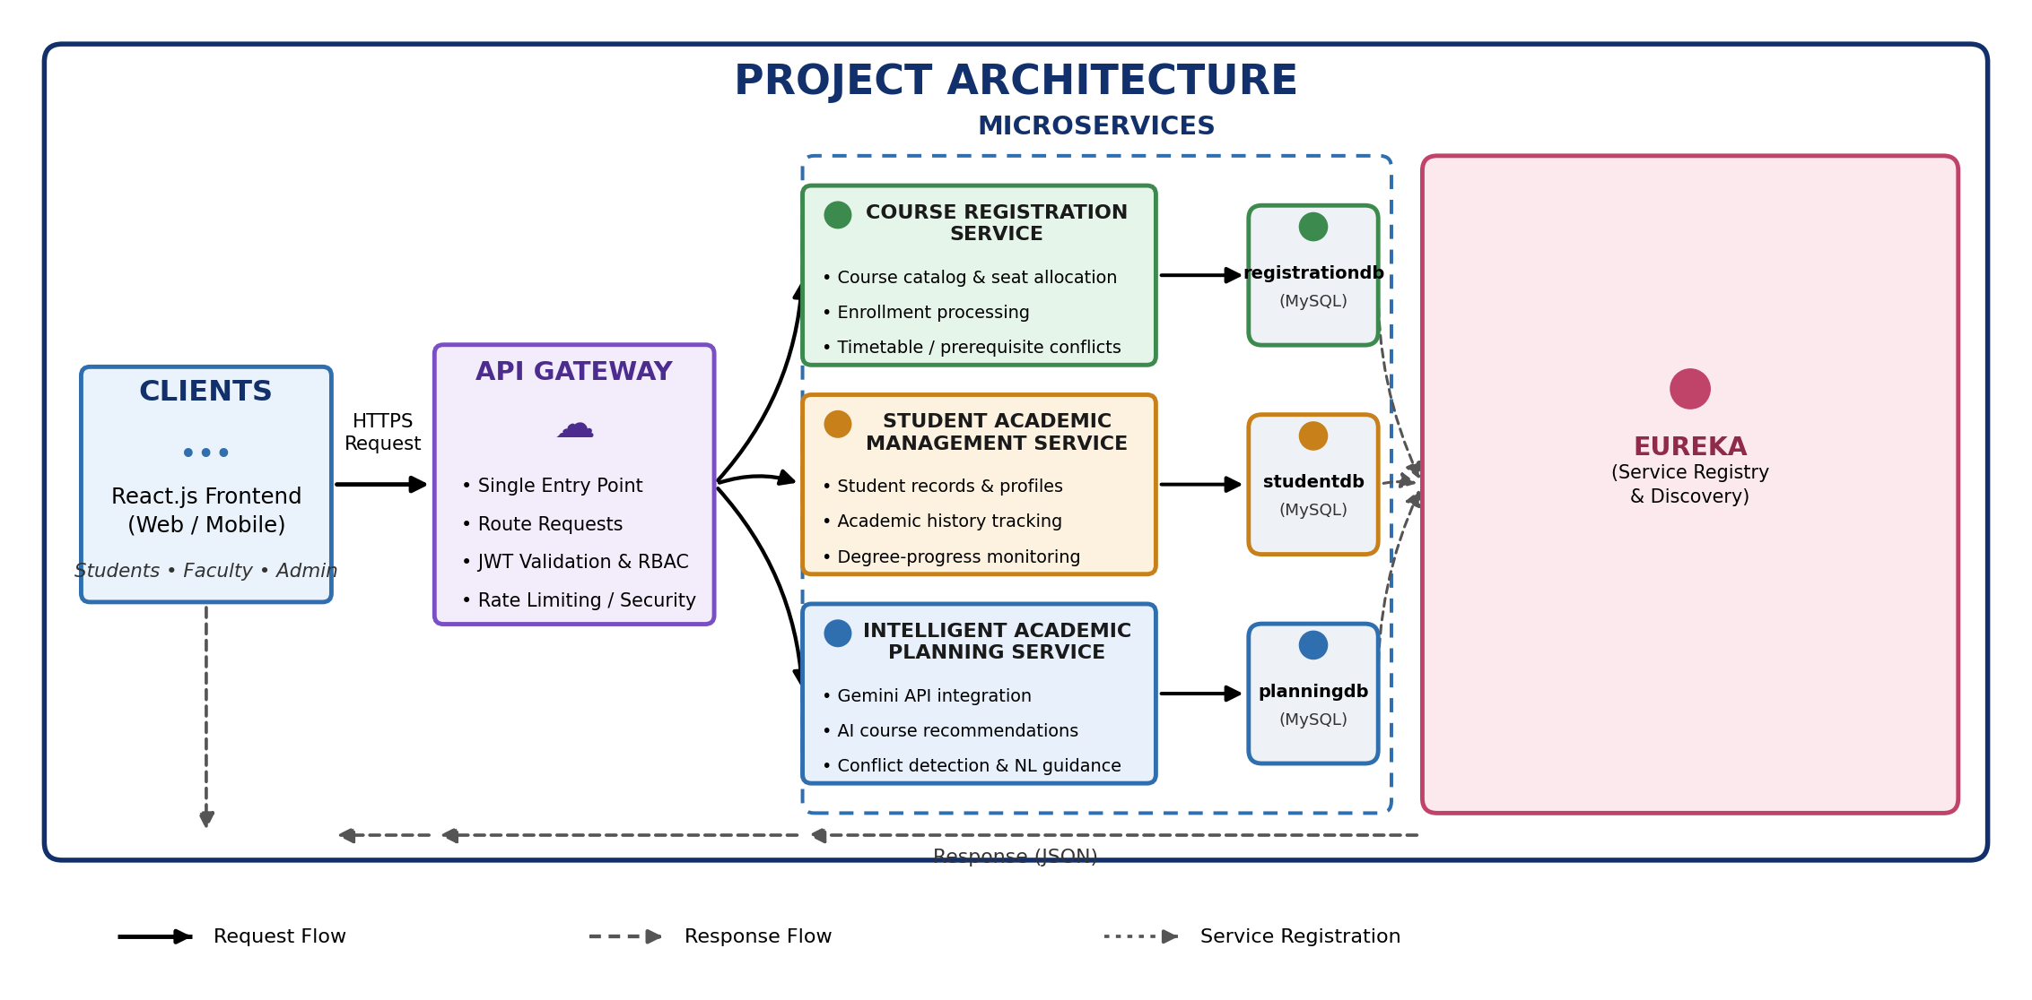
Project Architecture / Project Overview

Slide 9
Feasibility and Project Plan
Technically feasible with Spring Boot, React.js, MySQL, and the Gemini API; scoped for delivery across one academic semester by a 3-member team.
Phase | Key Activities | Duration | Milestone
Requirement Analysis & Design | Finalize scope, SOA service boundaries, DB schema, UI wireframes | Weeks 1-2 | Review 1 (this review)
Core Microservices Development | Build Course Registration & Student Academic Management services, MySQL schemas, REST APIs | Weeks 3-6 | Working registration + records APIs
AI Planning Service & Frontend | Integrate Gemini API for recommendations/conflict detection; build React.js SPA | Weeks 7-9 | Review 2
Security, Integration & Testing | JWT auth, role-based access, Postman test suites, end-to-end integration | Weeks 10-12 | Integrated system demo
Deployment & Final Review | Performance tuning, documentation, deployment, final presentation | Weeks 13-14 | Review 3 / Final Viva

